Slide 1
Percentage of a number
Miss L
Year 7

Slide 2
Learning Intentions
Students will be able to
To find the percentage of a number successfully

Slide 3

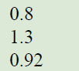
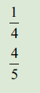
From last lesson
Decimals to percentages
Fractions to percentages
WICOR

Slide 4
From last lesson
Simplify the following ratio:
25 : 15
Turn the following ratio into a fraction:
3 : 6
Turn the following ratio into a decimal:
8 : 40
Turn the following ratio into a percentage:
2 : 18
WICOR

Slide 5
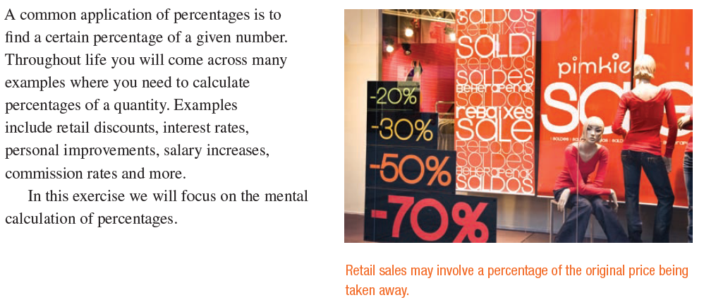
24
7
30
Topic: Ratio and Rates
Date:
EQ – How do we find a percentage of a number?

Slide 6
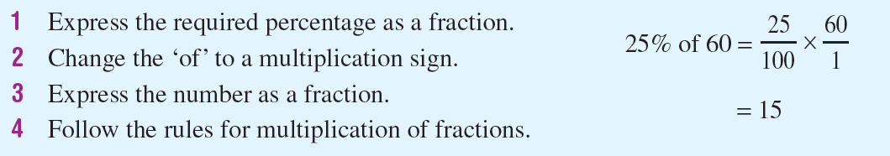

24
7
30
Topic: Ratio and Rates
Date:
EQ – How do we find a percentage of a number?
How to find a percentage of a number

Slide 7


Slide 8
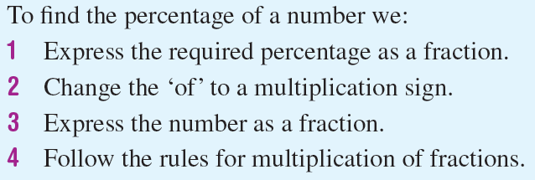
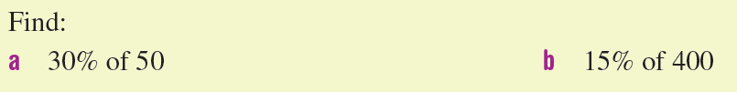
Practice
Notes:
Guide students through the question.
Option 2: Dot plots handout (Scaffolded for kids who may need extra help)

Slide 9
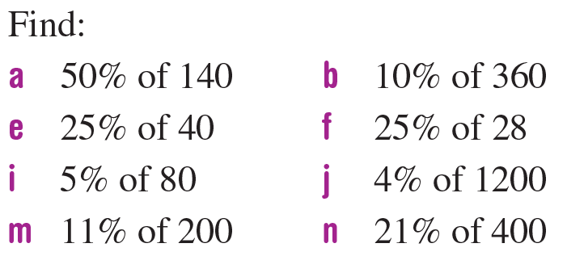
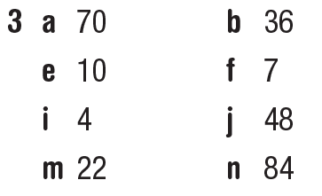
Task
Notes:
Guide students through the question.
Option 2: Dot plots handout (Scaffolded for kids who may need extra help)

Slide 10
Exit pass
Steps to Leave the Classroom
Complete the Mystery Amount Activity
Fill in your summery
Show your teacher these two steps before you may pack up
WICOR
Notes:
Guide students through the question.
Option 2: Dot plots handout (Scaffolded for kids who may need extra help)

